Slide 1
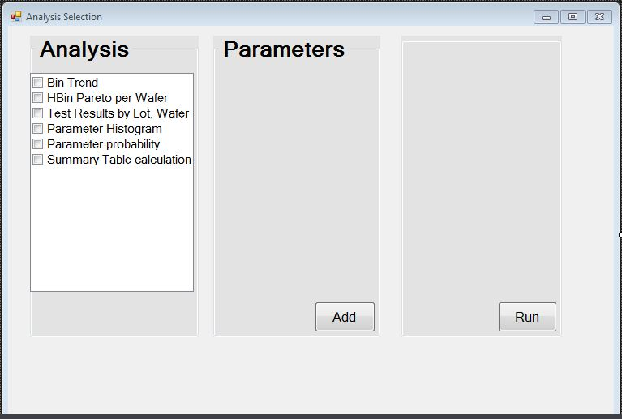
Analysis Selection

Slide 2
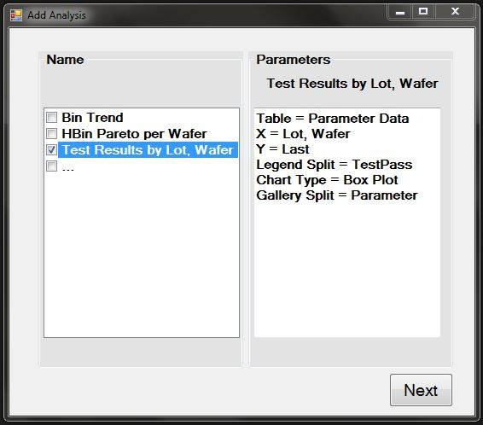
if the engineer pushes the <ADD> button

